Slide 1
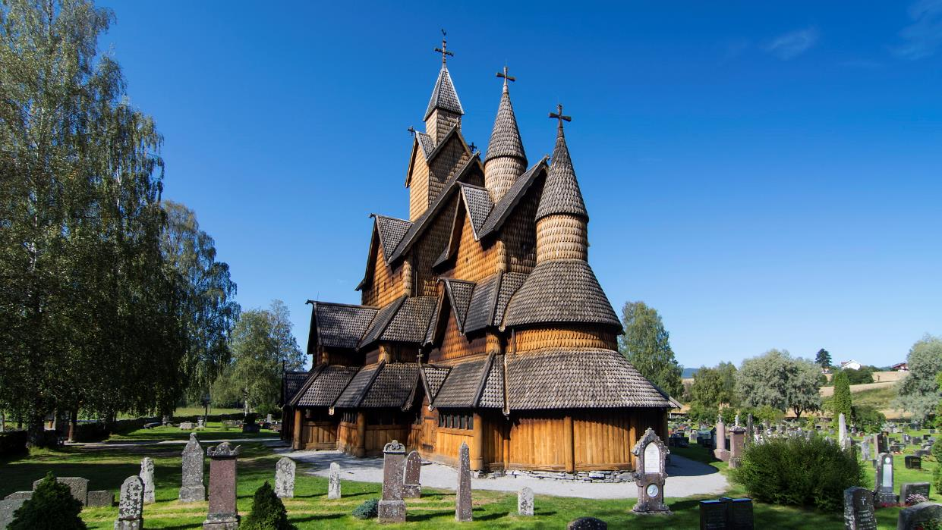
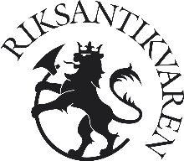
Management of cultural heritage in Norway
Adam Bielek
Levoca 10.10.24

Slide 2
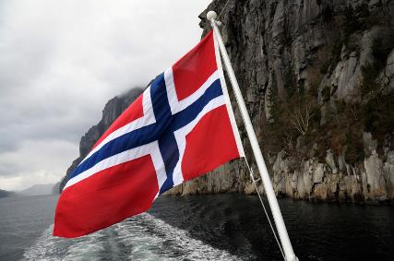
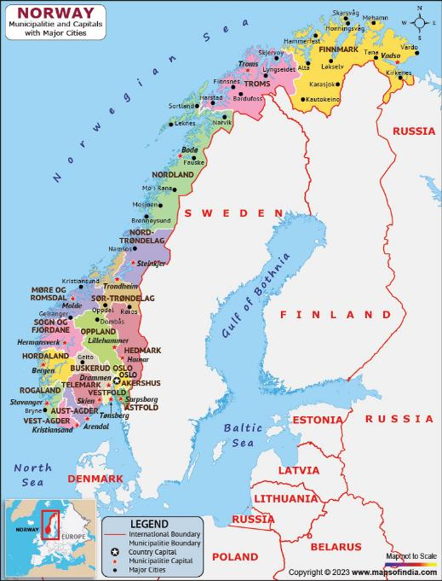

Facts about Norway
Norway is a constitutional monarchy. King Harald V wields no real political power and the parliament, Stortinget, is the highest authority. Although not in the EU, Norway is part of the European Economic Area and a member of NATO.
National day: 17 May (Constitution Day, 17 May 1814)
Form of government: Constitutional monarchy
Parliament: Stortinget (169 members)
EU membership: No
EEA Membership: Since Saturday, 1 January 1994
Head of state: King Harald V
Head of government (since September 2021): Prime Minister Jonas Gahr Støre (Labour)

Slide 3
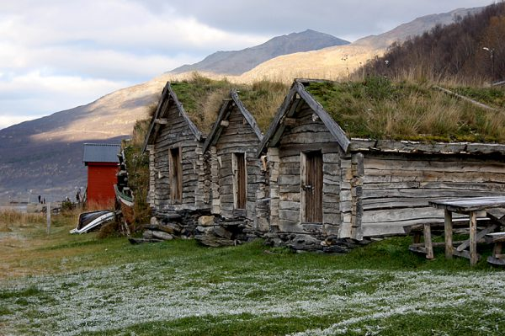
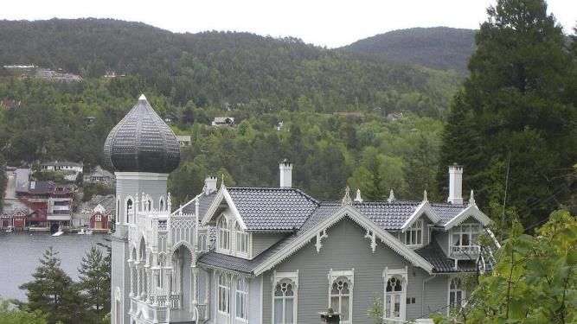

Definition of cultural heritige
Cultural monument is the trace of the people who have lived before us, their lives and work.
The term cultural heritage is often used for both intangible and material cultural heritage.
A cultural environment is an area where several cultural monuments form part of a larger context, such as an area in a city, a hamlet, a fishing village or an industrial area with factories, infrastructure and housing. Natural elements with cultural-historical value can also be part of a cultural environment.
220 000 registered objects of cultural heritige
8 on the UNECSCO list
Alle cultural monuments which are older than reformation ( 1537) are automaticly defined like cultural heriritge

Slide 4
Management of cultural heritage in Norway
Ministry of Climate and Environment
The Ministry of Climate and Environment is primarily responsible for the management of cultural heritage monuments, sites and cultural environments in Norway.
The Directorate for Cultural Heritage
must implement government policy and provide the basis for policy
is the Ministry of Climate and Environment’s advisory body in all matters relating to cultural heritage and cultural environments
has the authority to protect cultural heritage, make objections and is the administrative appeals body
has the authority to grant exemptions regarding selected cultural heritage monuments and sites. This applies to the four large medieval towns ( Oslo, Trondheim, Berge and Stavanger ) as well as certain buildings and sites
is the system manager responsible for the development of digital services that ensure unified cultural heritage management, and manages key data on cultural heritage monuments and sites in public administration
is responsible for church management

Slide 5
Management of cultural heritage in Norway
County Authority/Sámi Parliament
are responsible for county cultural heritage monuments and sites and for cultural heritage monuments and sites in Sámi areas
are responsible for safeguarding cultural heritage monuments and sites in relation to land-use planning i.e. ensure that cultural heritage monuments, sites and environments are taken into consideration when planning, also at municipal levels
have decision-making authority in accordance with the Cultural Heritage Act for the majority of cultural heritage monuments and sites cf. new liability regulations
can prepare cases for the Directorate for Cultural Heritage
have responsibility for and manage the work regarding regional planning strategies, regional plans and planning provisions

Slide 6
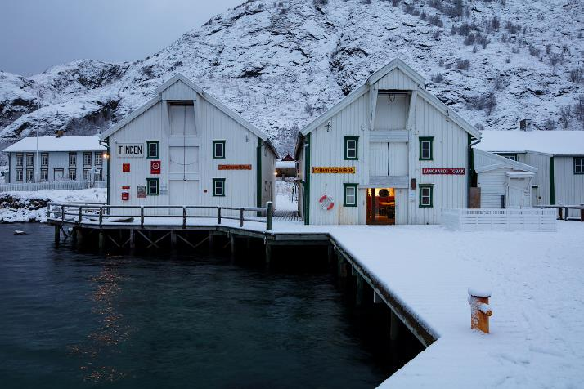
Management of cultural heritage in Norway
Municipalities
are responsible for safeguarding and facilitating the use of cultural heritage monuments and sites, cultural environments and landscapes in land-use and community planning. The Planning and Building Act is the most important legal tool, but municipalities also have other measures at their disposal such as grants and property tax exemptions.
certain city municipalities have a cultural heritage manager. In addition, some municipalities have positions that conduct equivalent tasks
Tinden Trading place på Tindsøya i Øksnes kommune i Vesterålen. Foto: Trond A. Isaksen, Directorate for Cultural Heritage

Slide 7
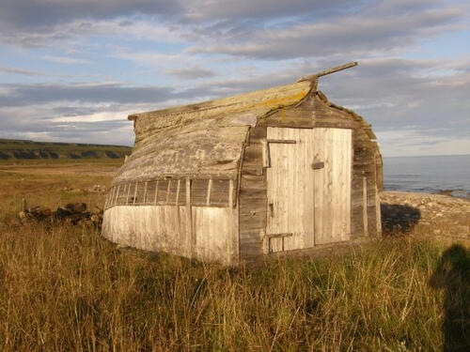
Management of cultural heritage in Norway
The archaeological museums
The archaeological museums are the Directorate for Cultural Heritage’s professional advisory bodies regarding cultural heritage monuments and sites of archaeological importance on land and under water.
Cultural heritage monuments and sites of archaeological importance are automatically protected by law in accordance with the Cultural Heritage Act. Excavations can only be carried out after exemption from protection provisions has been granted.

Slide 8
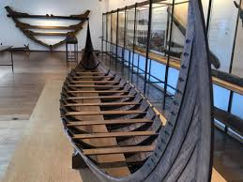
Management of cultural heritage in Norway
The regional archaeological museums:
Museum of Cultural History, University of Oslo
The Museum of Archaeology, University of Stavanger
University Museum of Bergen
NTNU University Museum, Trondheim
The Arctic University Museum of Norway​, Tromsø
These museums are responsible for underwater archaeology:
Norwegian Maritime Museum, Oslo
Museum Stavanger
Bergen Maritime Museum
NTNU University Museum, Trondheim
The Arctic University Museum of Norway​, Tromsø

Slide 9
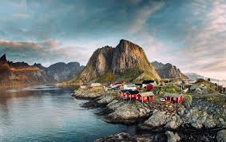
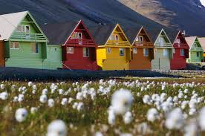
Management of cultural heritage in Norway
The Norwegian Institute for Cultural Heritage Research (NIKU) investigates cultural heritage monuments and sites of archaeological importance from the Middle Ages. This involves church sites, monasteries, fortifications and the eight medieval towns (Bergen, Hamar, Oslo, Sarpsborg, Skien, Stavanger, Trondheim and Tønsberg).
Governor of Svalbard
Cultural heritage management on Svalbard is administered by the Governor, as determined in the Svalbard Environmental Protection Act.

Slide 10


Slide 11
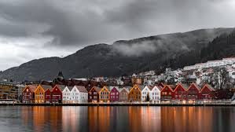
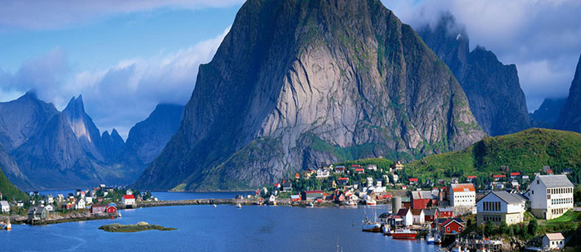

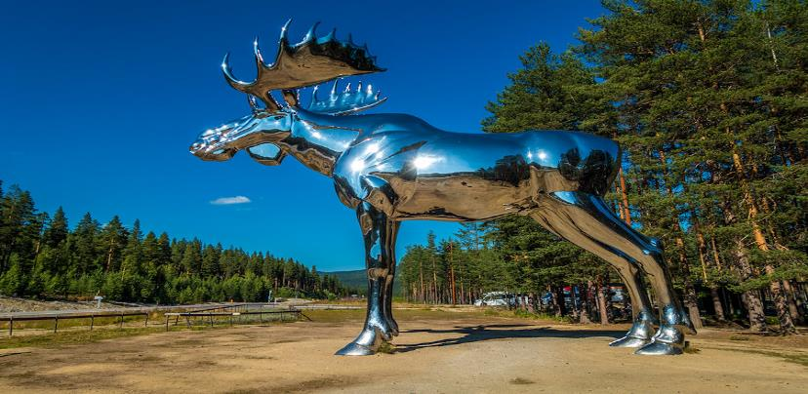
www.visitnorway.com
www.riksantikvaren.no
www.norsk-kutursenter.no

