Slide 1
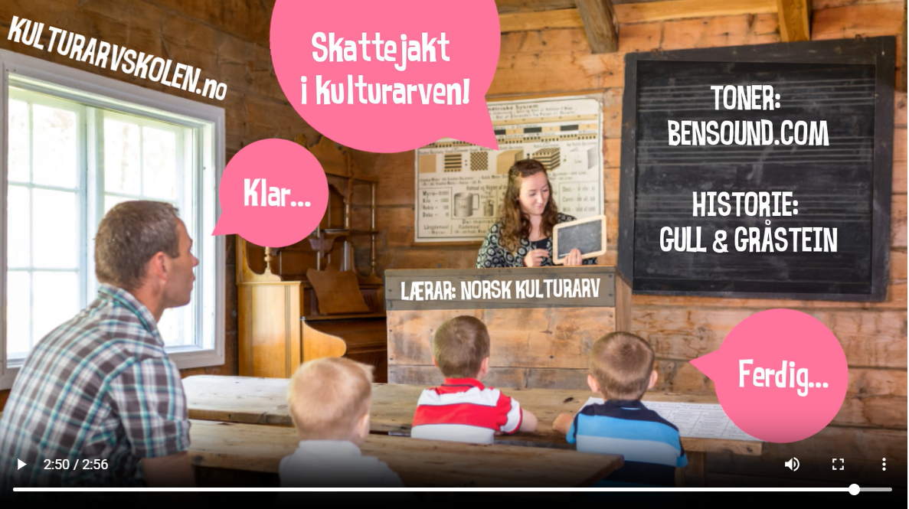
THE CULTURAL HERITAGE SCHOOL
PROTECTION THROUGH USE
Marita Grøtan Heggstad

Slide 2


The Cultural Heritage School
- Developed by Norsk Kulturarv
- An interest organization
- Aim of securing and passing on our cultural heritage to future generations.
- Through the sustainable use of cultural heritage along the coast, inland, in urban areas and living villages, Norwegian Cultural Heritage lays the foundation for both knowledge, learning and new business development based on our historical heritage.
- Norwegian Cultural Heritage works with attitude-creating activities, information and conveys values ​​that provide inspiration, knowledge and identity.
- Among other things, this learning platform for schools.

Slide 3
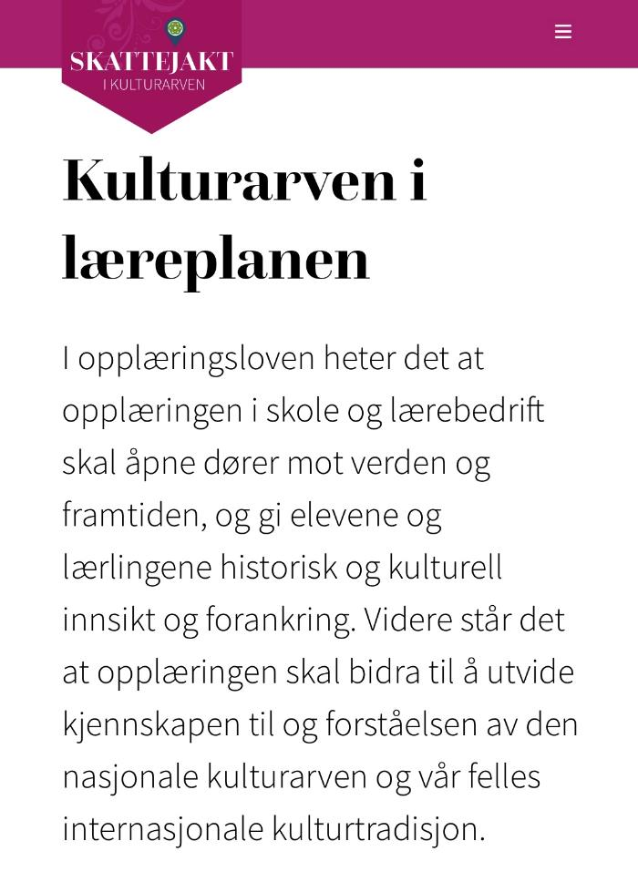
Cultural heritage in the curriculum
The Education Act states that education in schools and apprenticeships must:
  open doors to the world and the future
  give students and apprentices historical and cultural insight and grounding
  the training should contribute to expanding knowledge and understanding of the national cultural heritage and our common international cultural tradition

Slide 4
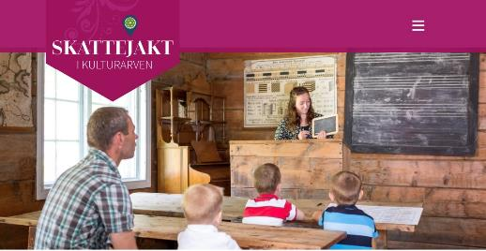
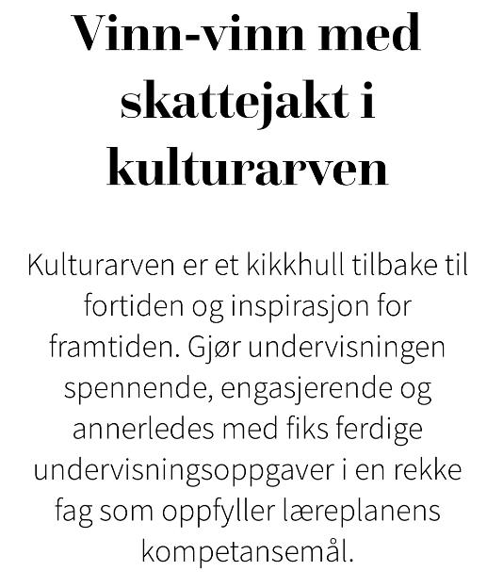
WIN-WIN
A treasure hunt in the cultural heritage.
Cultural heritage is:
A peak into the past and an inspiration for the future
Makes teaching exciting, engaging and different
With ready-made teaching tasks
A number of subjects that meet the curriculum’s competence targets

Slide 5
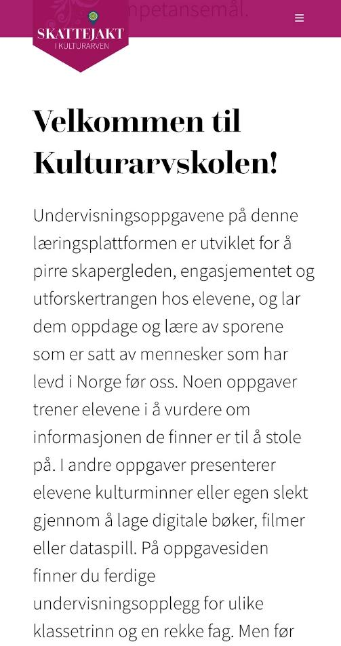
Welcome to the Cultural Heritage School!
The teaching tasks on this learning platform:
  Developed to stimulate the joy of creation, commitment and the urge to explore
  Allow the students to discover and learn from the traces left by people who have lived in Norway before us
  Some tasks train students to assess whether the information they find can be trusted
  In other tasks, students present cultural heritage or their own family by creating digital books, films or computer games
  On the assignment page you will find teaching plans for various grade levels and a number of subjects

Slide 6
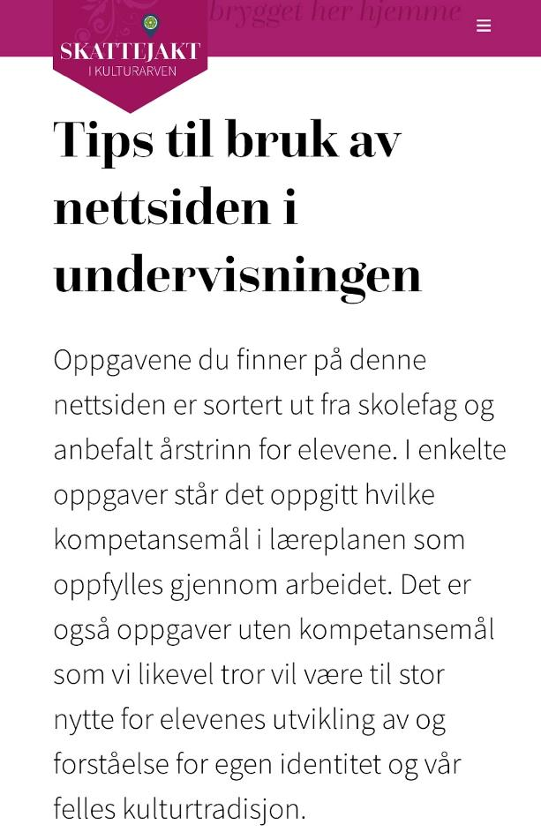
Tips for using the website in teaching
The assignments you will find on this website:
  Are sorted by school subject and recommended year level for the students
  In some tasks, it is stated which competence targets in the curriculum are fulfilled through the work.
  Also tasks without competence targets
    will nevertheless be of great benefit to the pupils' development of and understanding of their own identity and our common cultural tradition.

Slide 7
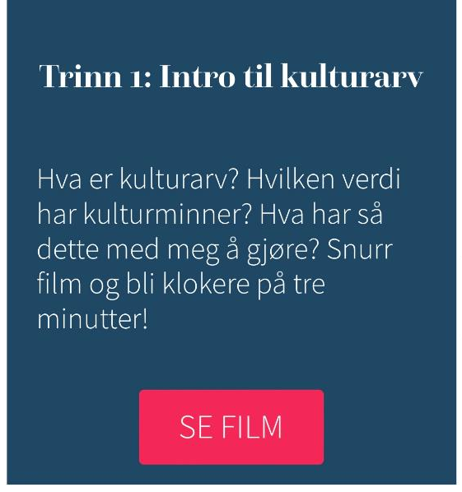
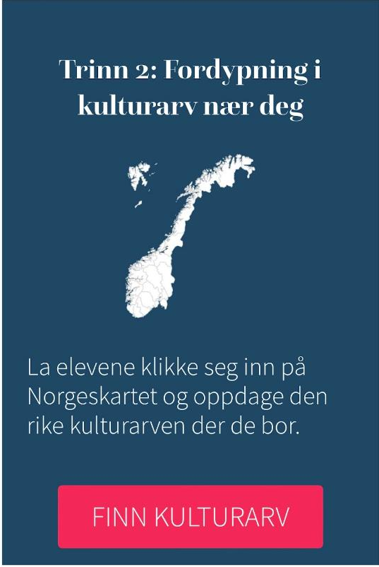
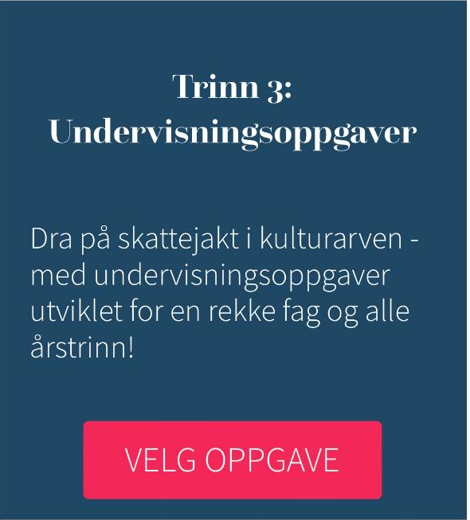
Step 1: Intro to cultural heritage
What is cultural heritage? What is the value of cultural heritage? So what does this have to do with me? Spin film and become wiser in three minutes!
Step 3: Teaching assignments
Go on a treasure hunt in the cultural heritage - with teaching tasks developed for a number of subjects and all year levels!
Step 2: Immersion in cultural heritage near you
Let the students click on the map of Norway and discover the rich cultural heritage where they live.

Slide 8
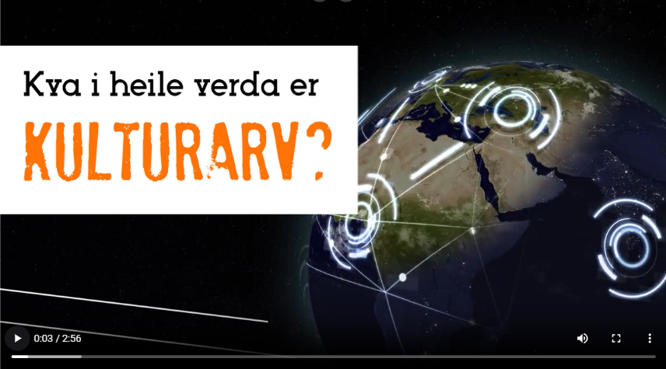
WHAT IS CULTURAL HERITAGE?
Step 1: Intro to cultural heritage
What is cultural heritage? What is the value of cultural heritage? So what does this have to do with me? Spin film and become wiser in three minutes!
An introduction to Cultural Heritage for Dummies
https://www.kulturarvskolen.no/kulturarven/#video

Slide 9
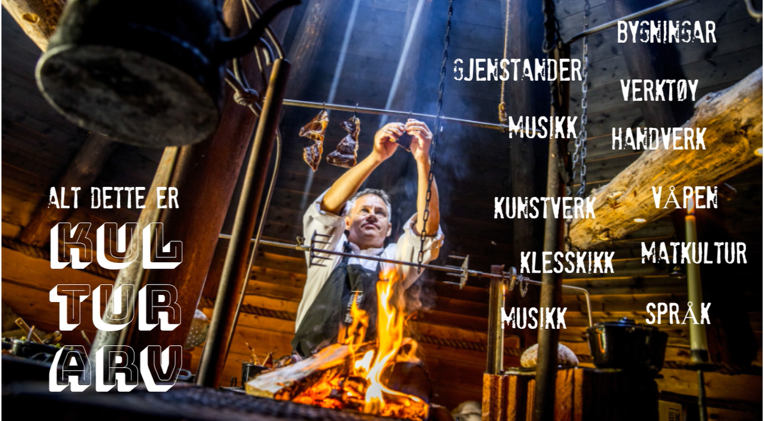
CULTURAL HERITAGE IS…
TOOLS
HANDCRAFT
WEAPONS
FOOD CULTURE
LANGUAGES
OBJECTS
MUSIC
BUILDINGS
ARTWORK
DRESS CODE

Slide 10
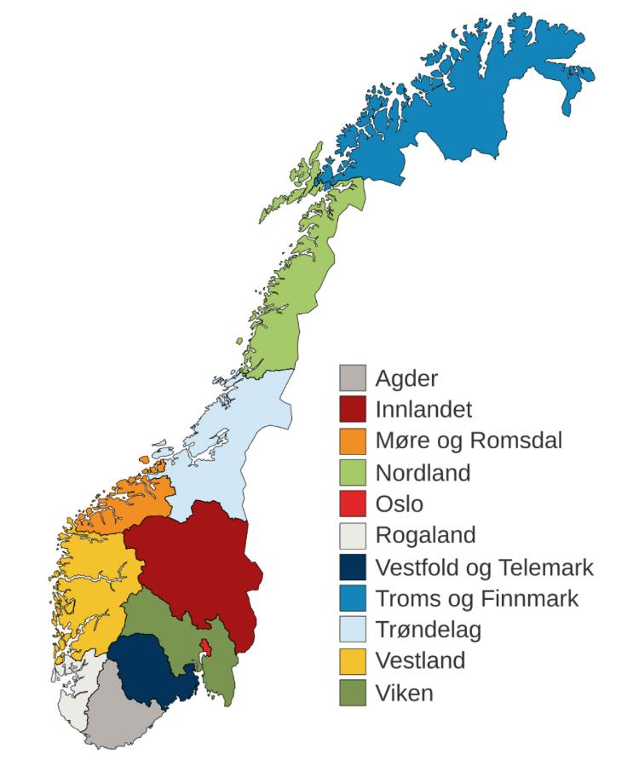

CLICK ON THE MAP OF NORWAY
Step 2: Immersion in cultural heritage near you
Let the students click on the map of Norway and discover the rich cultural heritage where they live.
Discover the rich cultural heritage where you live
Norway divided into counties

Slide 11
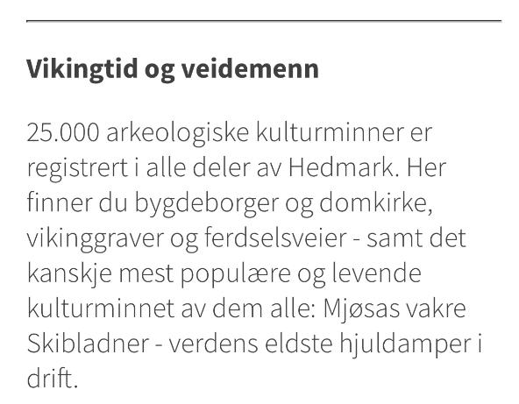
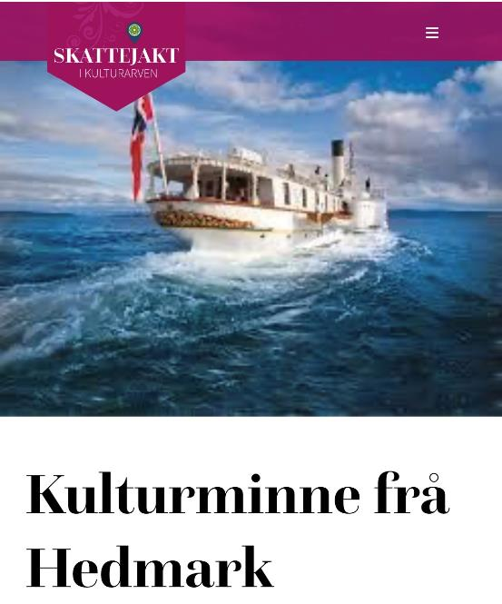
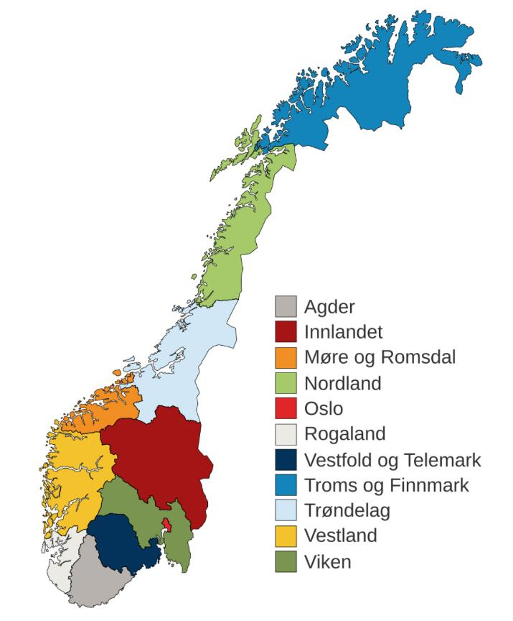
HEDMARK COUNTY
- Cultural monuments
Viking Age and surveyors
25,000 archaeological cultural monuments are registered in all parts of Hedmark
Here you will find village towns and cathedrals, Viking graves and roads
  as well as perhaps the most popular and living cultural monument of them all: Mjøsa's beautiful Skibladner - the world's oldest operating paddle steamer.

Slide 12
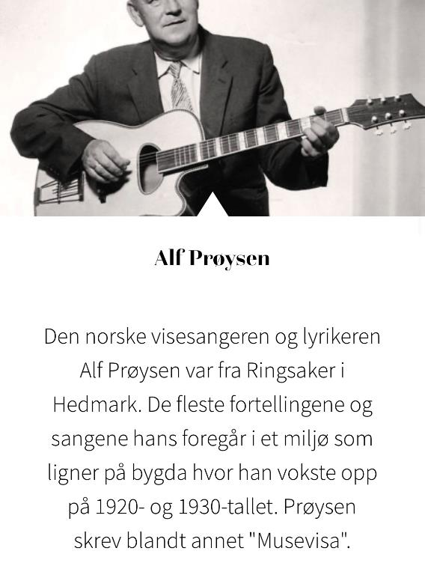
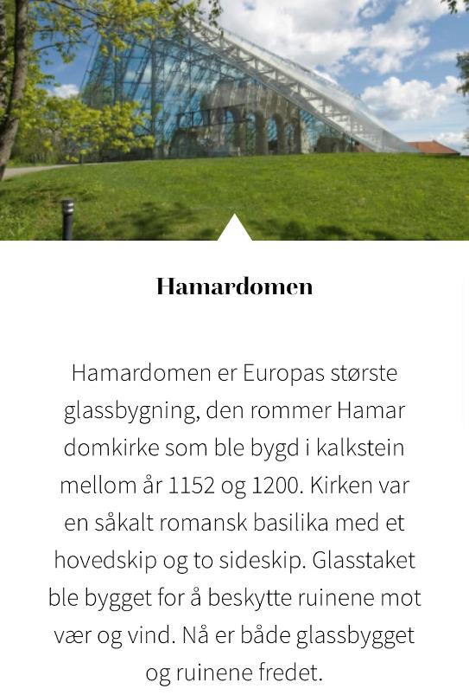
The Norwegian singer and lyricist Alf Prøysen was from Ringsaker in Hedmark. Most of his stories and songs take place in an environment similar to the village where he grew up in the 1920s and 1930s. Prøysen wrote, among other things, "Musevisa".
Hamardomen
Hamar Cathedral is Europe's largest glass building, it houses Hamar Cathedral, which was built in limestone between 1152 and 1200. The church was a so-called Romanesque basilica with a main nave and two side naves. The glass roof was built to protect the ruins from weather and wind. Now both the glass building and the ruins are protected.

Slide 13
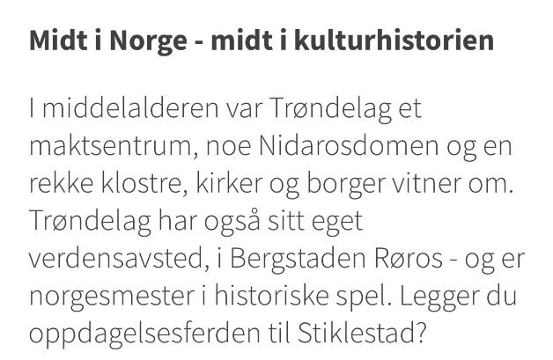
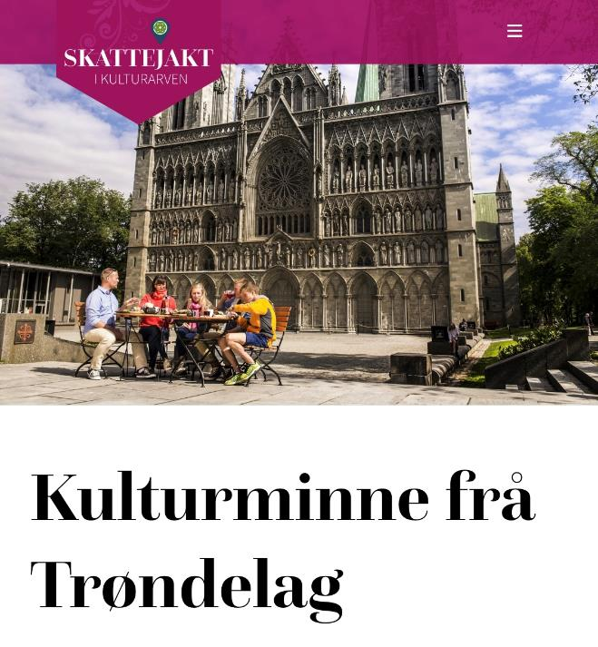
TRØNDELAG COUNTY
- Cultural monuments
In the middle of Norway - in the middle of cultural history
- In the Middle Ages, Trøndelag
was a center of power, as evidenced by the Nidaros Cathedral and a number of monasteries, churches and towns.
Trøndelag also has its own world
venue, in Bergstaden Røros - and is the Norwegian champion in historical games.
Are you planning your journey of discovery to Stiklestad?

Slide 14
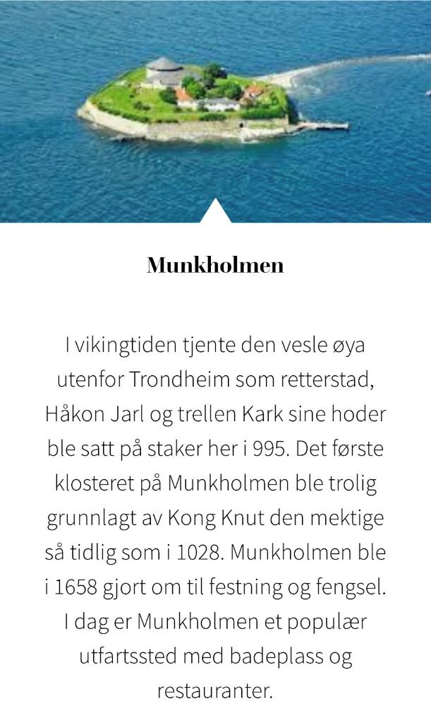
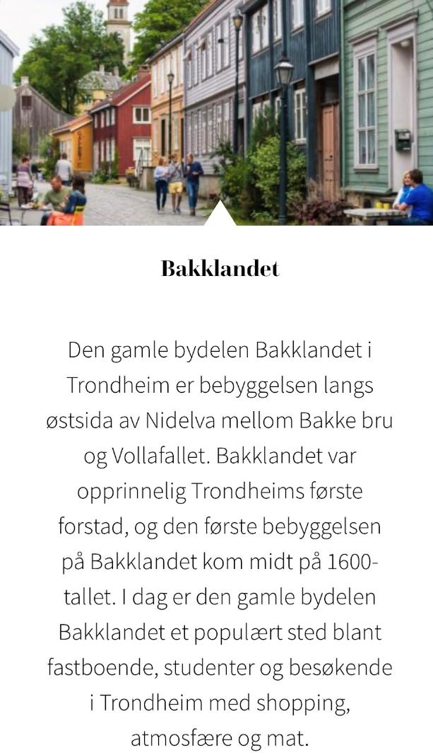
Munkholmen
In the Viking Age, the tiny island outside Trondheim served as a judicial town, the heads of Jarl Håkon and the slave Kark were put on stakes here in 995. The first monastery on Munkholmen was probably founded by King Knut the Mighty as early as 1028. Munkholmen was in 1658 made into a fortress and prison. Today, Munkholmen is a popular resort with bathing areas and restaurants.
Bakklandet
The old district of Bakklandet in Trondheim is the settlement along the east side of the Nidelva between Bakke bridge and Vollafallet. Bakklandet was originally Trondheim's first suburb, and the first settlement on Bakklandet came in the middle of the 17th century. Today, the old district of Bakklandet is a popular place among permanent residents, students and visitors to Trondheim with shopping, atmosphere and food.

Slide 15
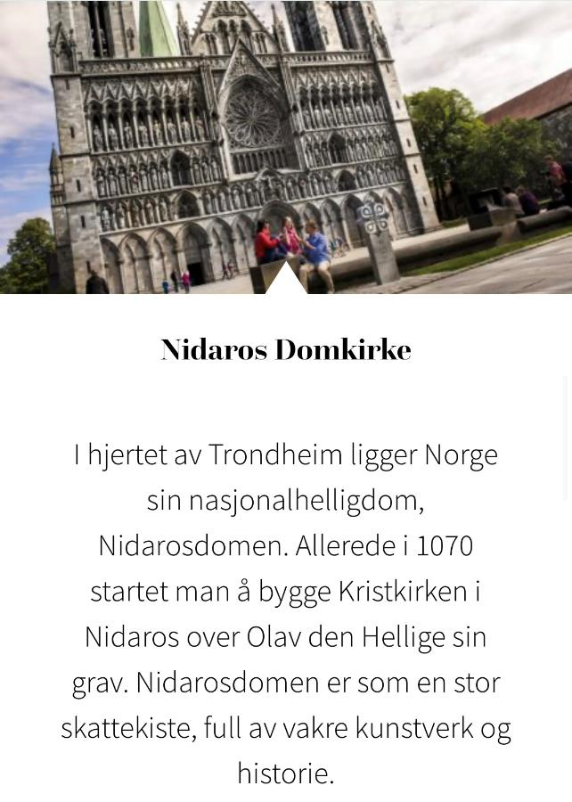
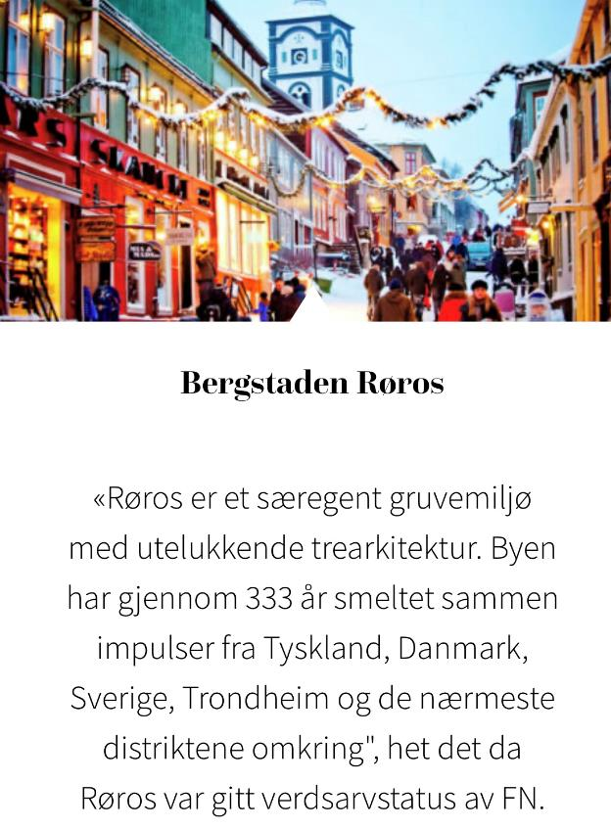

Nidaros Cathedral
In the heart of Trondheim lies Norway's national shrine, Nidaros Cathedral. As early as 1070, they started building the Christ Church in Nidaros over Olav the Holy's grave. Nidaros Cathedral is like a large treasure chest, full of beautiful works of art and history.
The mountain city of Røros
"Røros is a distinctive mining environment with exclusively wooden architecture. Throughout 333 years, the city has fused together impulses from Germany, Denmark, Sweden, Trondheim and the surrounding districts", it was said when Røros was given world heritage status by the UN.

Slide 16
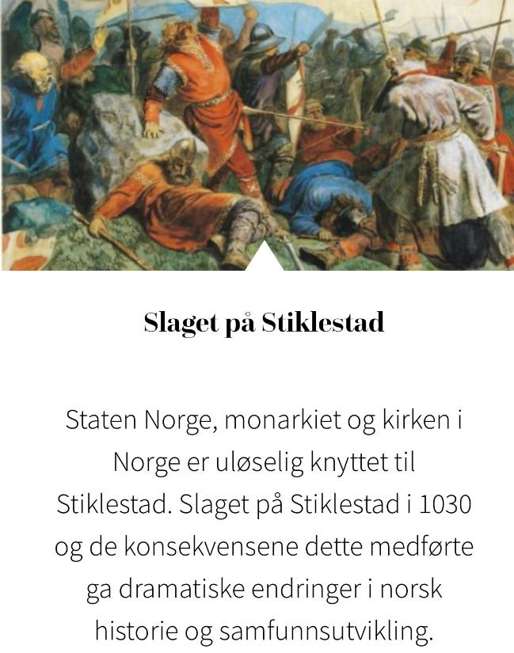
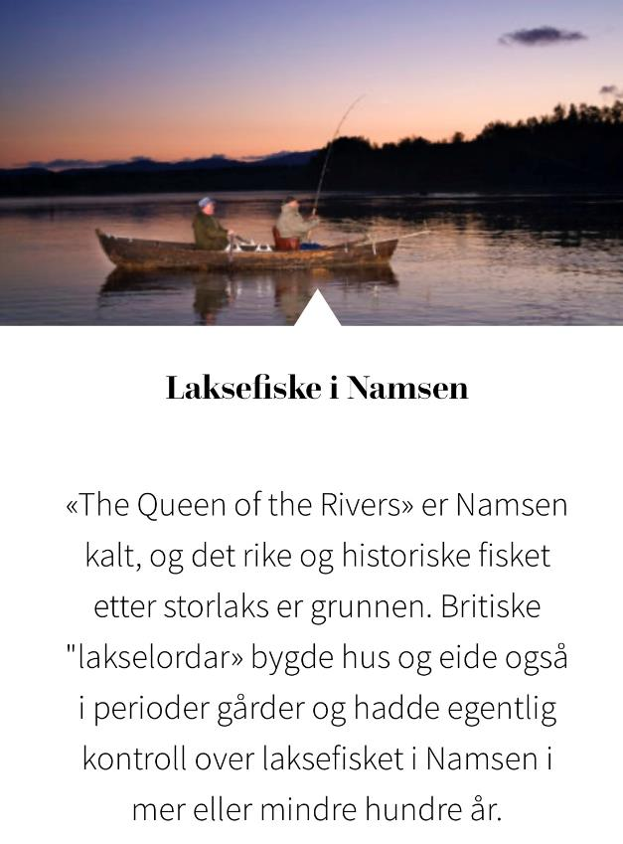
The Battle of Stiklestad
The state of Norway, the monarchy and the church in Norway are inextricably linked to Stiklestad. The Battle of Stiklestad in 1030 and the consequences this entailed brought about dramatic changes in Norwegian history and social development.
Salmon fishing in Namsen
Namsen is called "The Queen of the Rivers", and the rich and historic fishing for large salmon is the reason. British "salmon lords" built houses and also occasionally owned farms and actually had control over salmon fishing in Namsen for more or less a hundred years.

Slide 17
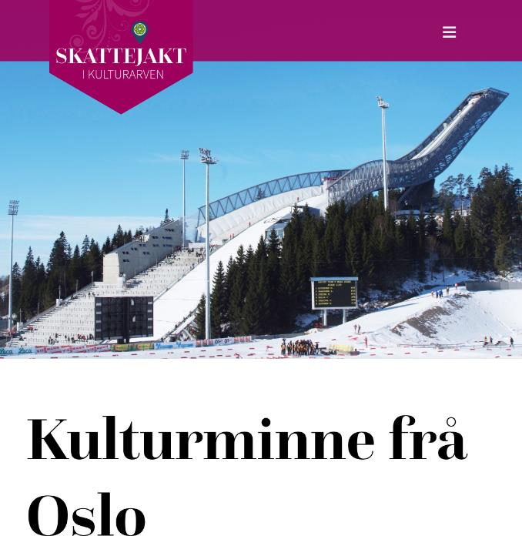
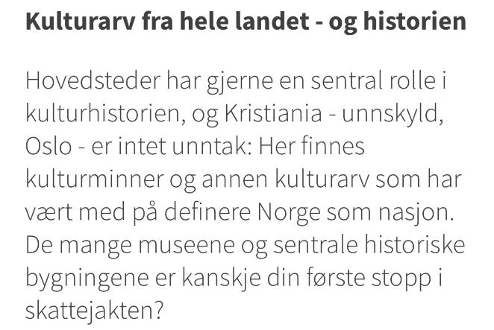
OSLO COUNTY
- Cultural monuments
Cultural heritage from all over the country - and history
Capitals often have a central role in cultural history, and Kristiania - sorry, Oslo - is no exception:
- Here you can find cultural monuments and other cultural heritage that have helped define Norway as a nation.
- The many museums and central historical buildings are perhaps your first stop in the treasure hunt?

Slide 18
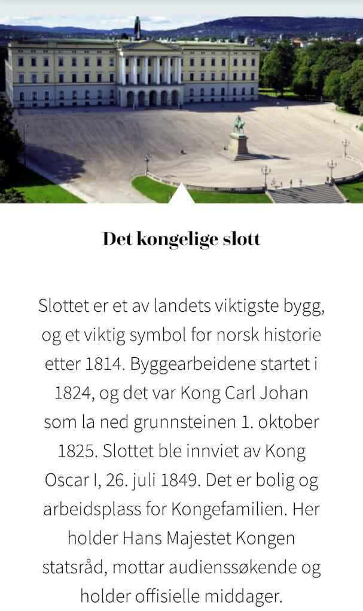
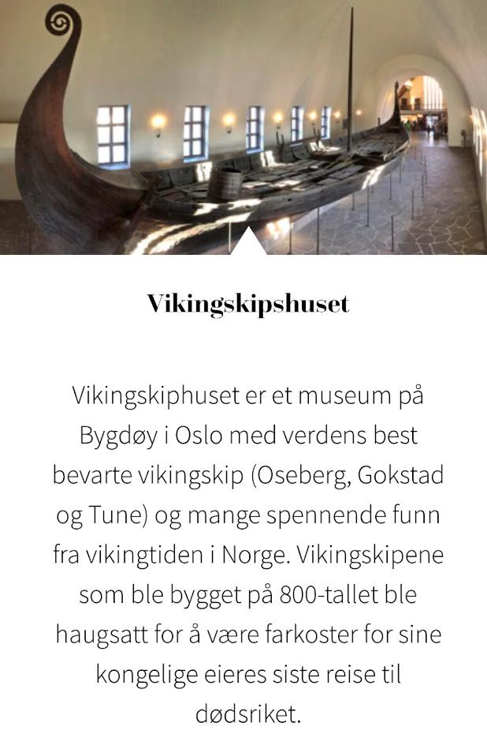
The Royal Castle
The castle is one of the country's most important buildings, and an important symbol of Norwegian history after 1814. Construction work began in 1824, and it was King Carl Johan who laid the foundation stone on 1 October 1825. The castle was inaugurated by King Oscar I on 26 July 1849 It is a residence and workplace for the Royal Family. Here His Majesty the King holds cabinet meetings, receives audience seekers and holds official dinners.
The Viking Ship House
The Viking Ship House is a museum on Bygdøy in Oslo with the world's best-preserved Viking ships (Oseberg, Gokstad and Tune) and many exciting finds from the Viking Age in Norway. The Viking ships that were built in the 8th century were piled up to be vessels for their royal owners' last journey to the underworld.

Slide 19
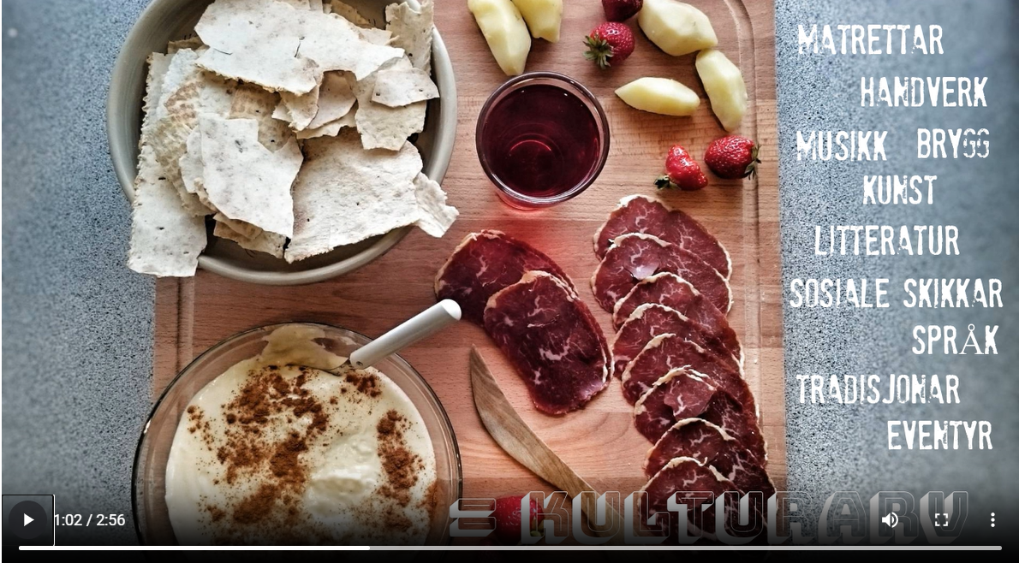
CULTURAL HERITAGE IS…
SOCIAL CUSTOMS
LANGUAGE
TRADITIONS
FAIRY TALES
LITERATURE
FOOD
CRAFTS
MUSIC
BREW
ART

Slide 20
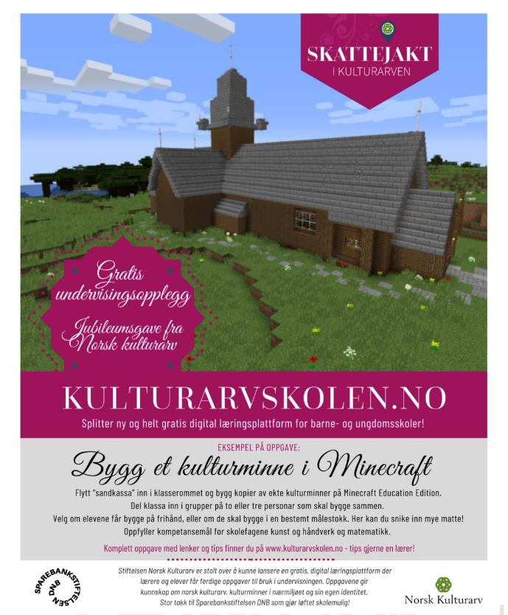
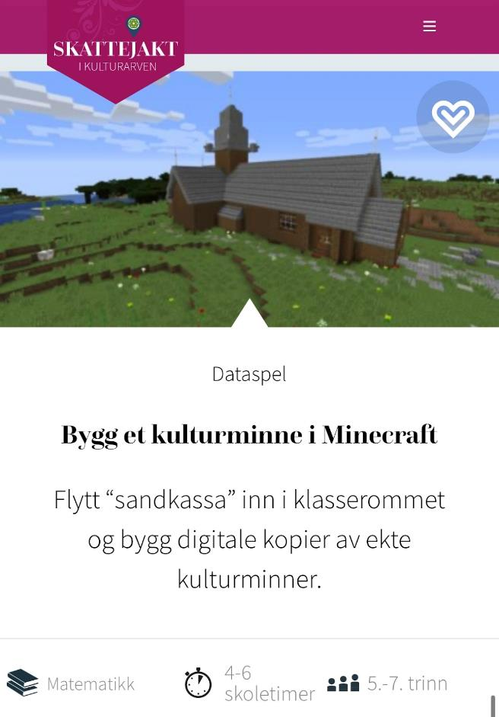
Step 3: Teaching assignments
Go on a treasure hunt in the cultural heritage - with teaching tasks developed for a number of subjects and all year levels!

Slide 21
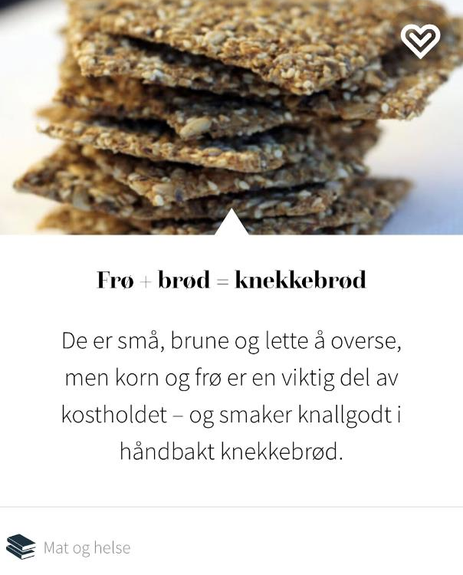
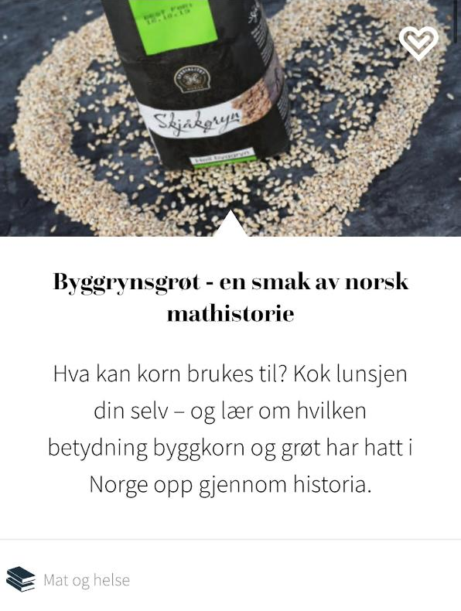

FOOD CULTURE
Step 3: Teaching assignments
Go on a treasure hunt in the cultural heritage - with teaching tasks developed for a number of subjects and all year levels!
Seeds + bread = shortbread
They are small, brown and easy to overlook, but grains and seeds are an important part of the diet - and taste great in hand-baked shortbread.
Barley porridge - a taste of Norwegian food history
What can grain be used for? Cook your own lunch - and learn about the importance barley grains and porridge have had in Norway throughout history.

Slide 22
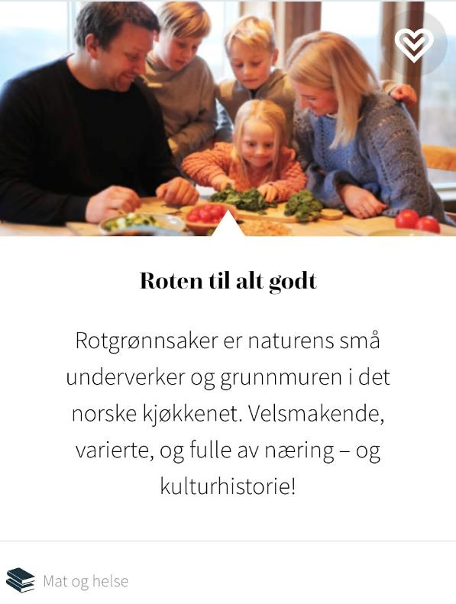
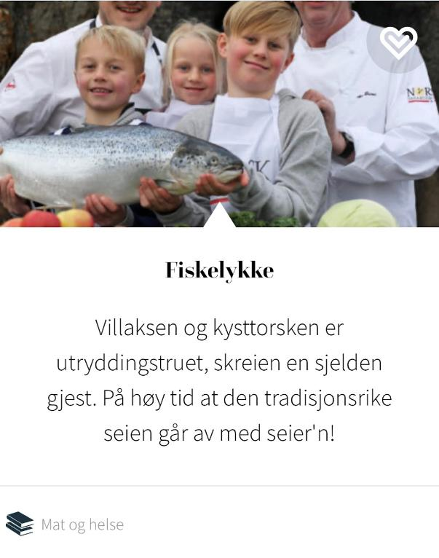
FOOD CULTURE
Step 3: Teaching assignments
Go on a treasure hunt in the cultural heritage - with teaching tasks developed for a number of subjects and all year levels!
Seeds + bread = shortbread
The root of all good things
Root vegetables are nature’s little wonders and the Foundation of Norwegian cuisine. Tasty, varied, and full of nutrition - and cultural history!
Good luck fishing
The wild salmon and the coastal cod are threatened with extinction, the skerrie a rare guest. It’s high time that the traditional victory goes away with victory!

Slide 23
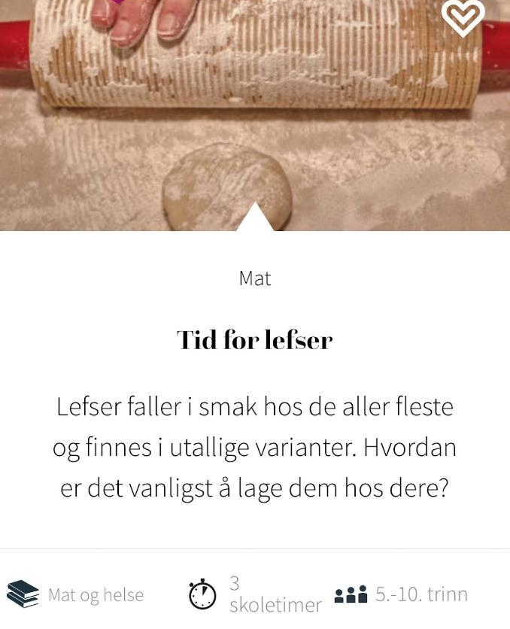
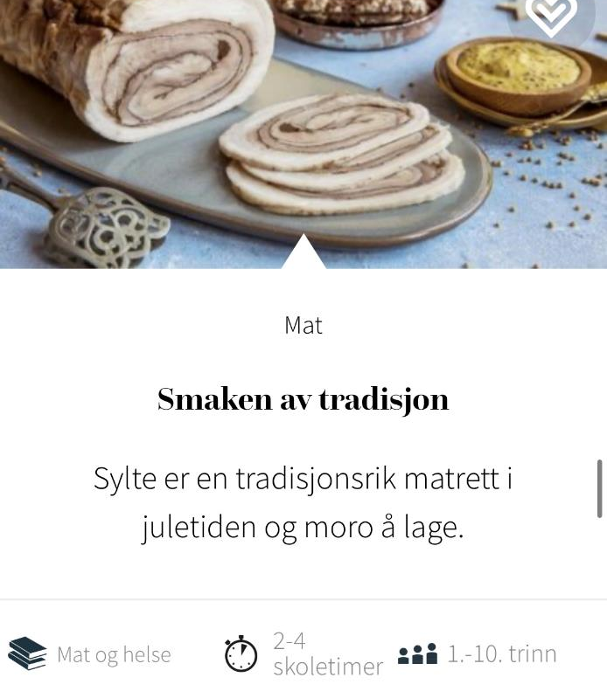
FOOD CULTURE
Step 3: Teaching assignments
Go on a treasure hunt in the cultural heritage - with teaching tasks developed for a number of subjects and all year levels!
Time for lefser
«Lefser» appeals to the vast majority of people and is available in countless varieties. How is it most common to make them at your place?
The taste of tradition
«Sylte» is a traditional dish at Christmas time and fun to make.

Slide 24
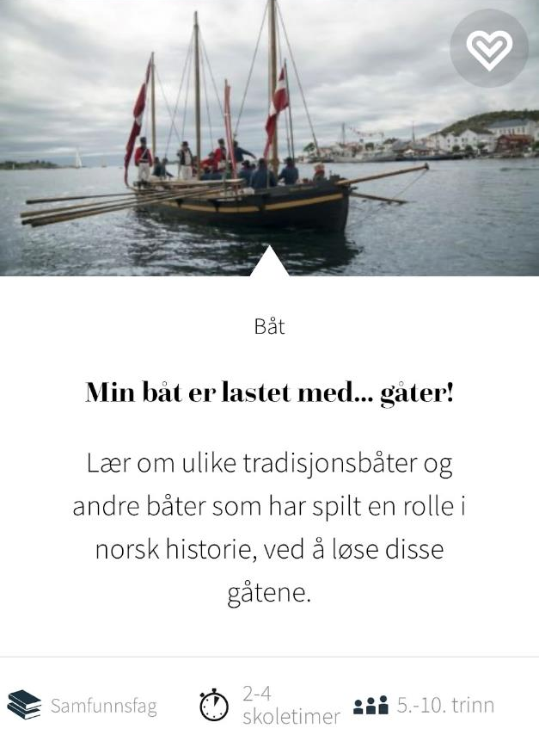
BOAT TRADITIONS
Step 3: Teaching assignments
Go on a treasure hunt in the cultural heritage - with teaching tasks developed for a number of subjects and all year levels!
My boat is loaded with… riddles.
Learn about various traditional boats and other boats that have played a role in Norwegian history by solving these riddles.

Slide 25
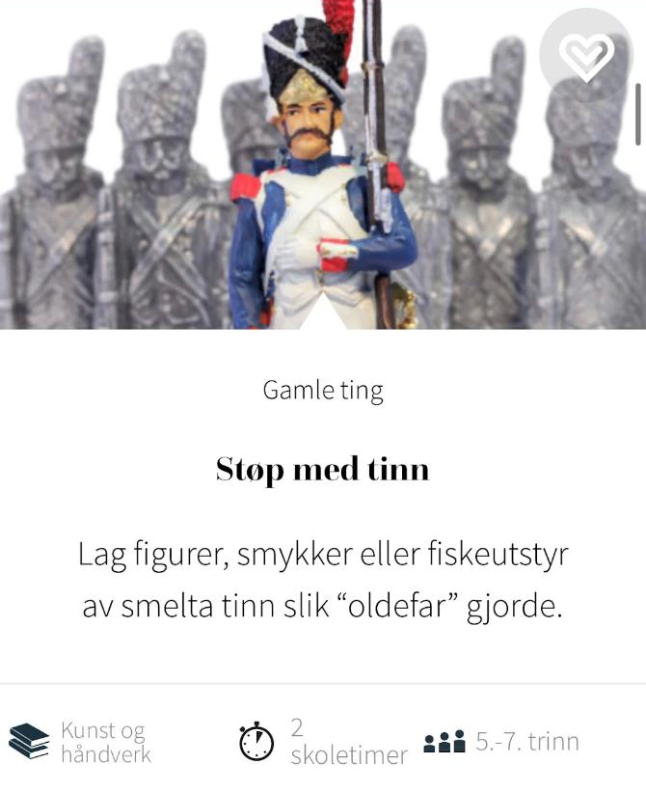
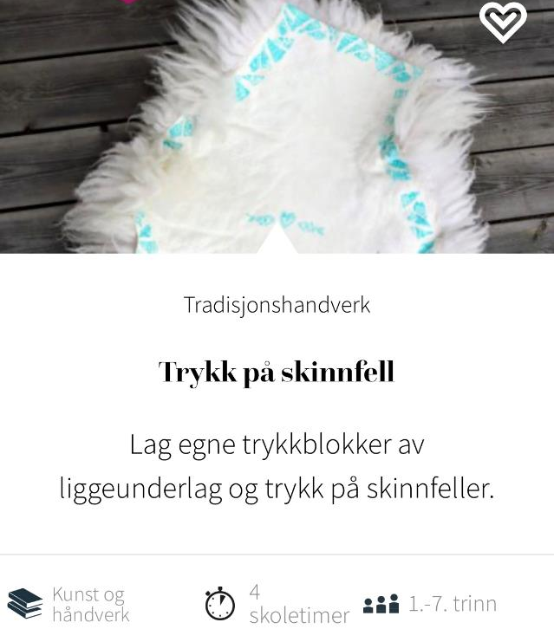
HANDCRAFT
Step 3: Teaching assignments
Go on a treasure hunt in the cultural heritage - with teaching tasks developed for a number of subjects and all year levels!
Print on skinfold
Make your own printing blocks from sleeping mats and print on leather traps.
Cast with tin
Make figurines, jewelery or fishing equipment from melted tin as «great grandfather» did.

Slide 26
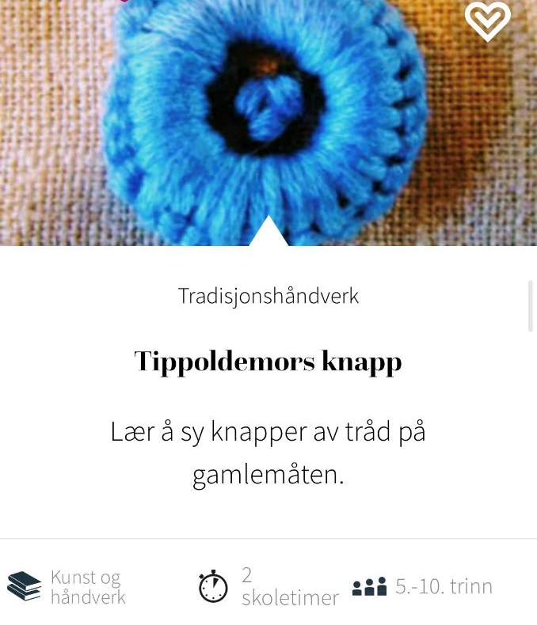
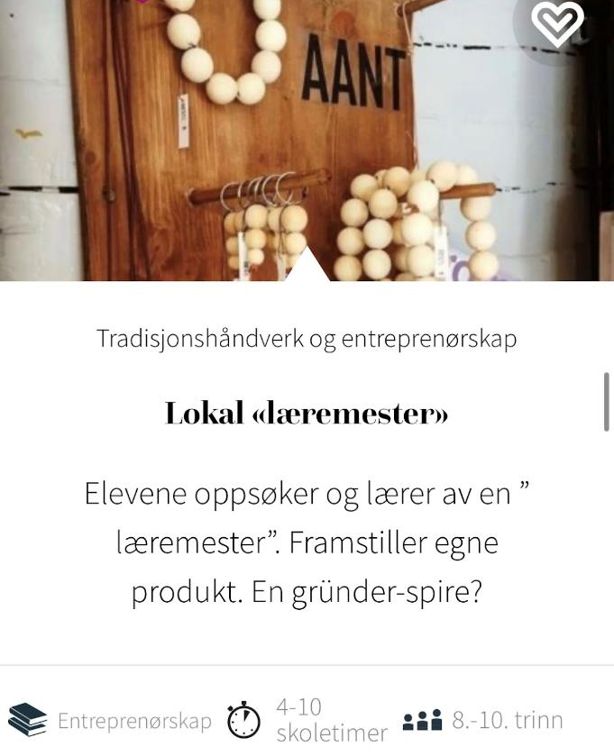
HANDCRAFT
Step 3: Teaching assignments
Go on a treasure hunt in the cultural heritage - with teaching tasks developed for a number of subjects and all year levels!
Great-great-grandmother’s button
Learn to sew buttons from thread the old-fashioned way.
Local «teacher»
The students seek out and learn from a «teacher». Produces own products. A budding entrepreneur?

Slide 27
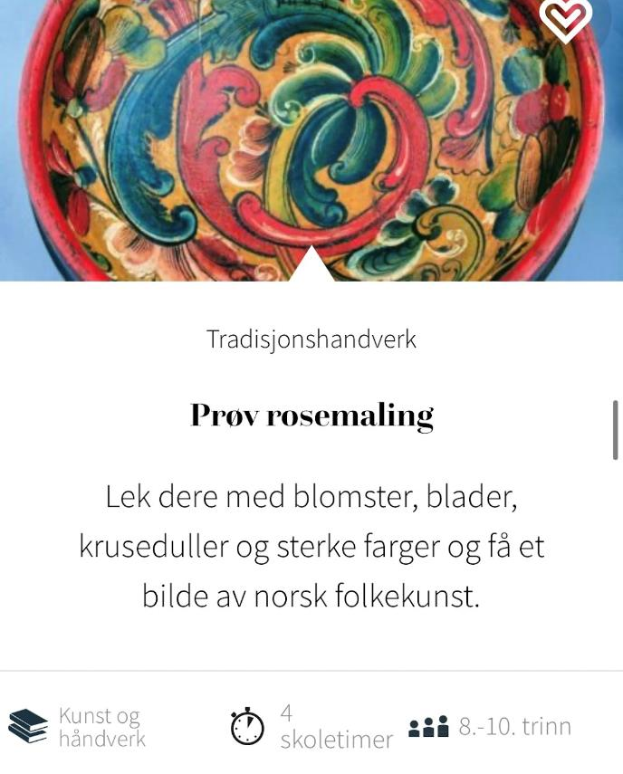
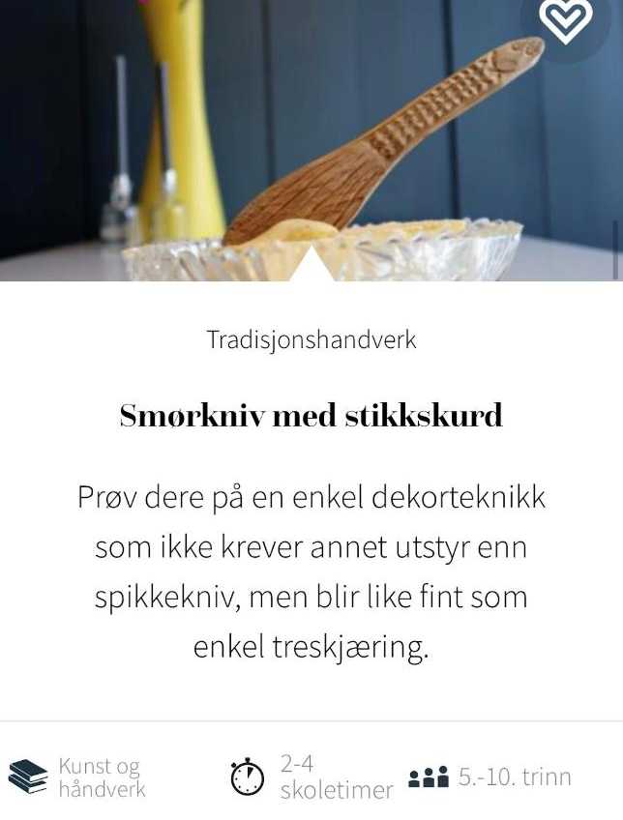
HANDCRAFT
Step 3: Teaching assignments
Go on a treasure hunt in the cultural heritage - with teaching tasks developed for a number of subjects and all year levels!
Try rose paint
Play with flowers, leaves, doodles and strong colors and get a picture of Norwegian folk art.
Butter knife with stabbing blade
Try your hand at a simple decoration technique that requires no equipment other than a nail knife, but looks just as good as simple wood carving.

Slide 28
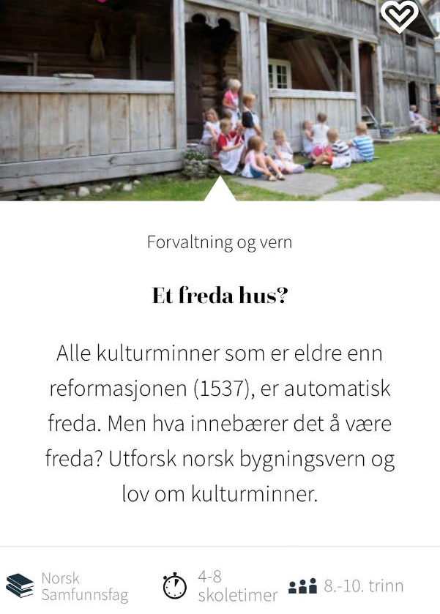

BUILDINGS
Step 3: Teaching assignments
Go on a treasure hunt in the cultural heritage - with teaching tasks developed for a number of subjects and all year levels!
A listed house?
All cultural monuments older than the Reformation (1537) are automatically protected. But what does it mean to be at peace? Explore Norwegian building protection and the Act on Cultural Heritage.
Build a cultural monument in Minecraft
Move the "sandbox" into the classroom and
build digital copies of real cultural monuments.

Slide 29
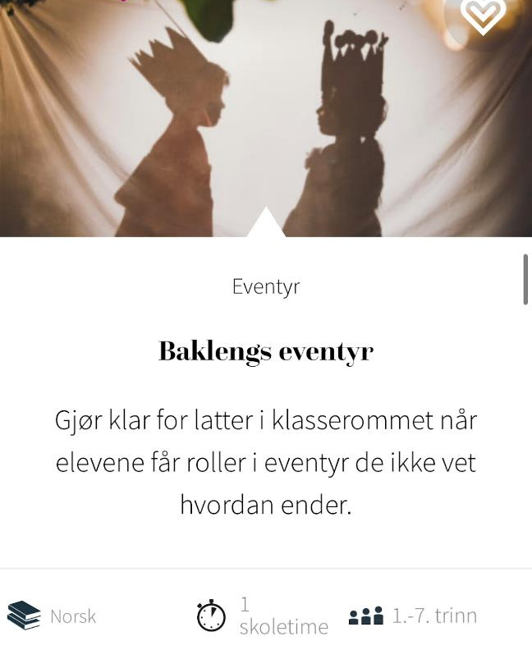
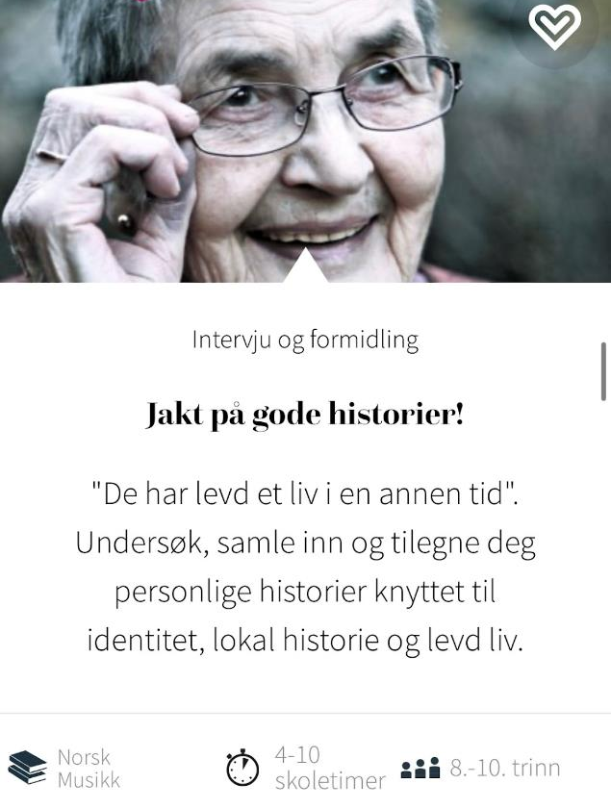
LANGUAGE
Step 3: Teaching assignments
Go on a treasure hunt in the cultural heritage - with teaching tasks developed for a number of subjects and all year levels!
Backwards fairy tale
Prepare for laughter in the classroom as students are cast in adventures they don’t know how to end.
Search for good stories!
«They have lived a life in another time». Research, collect and acquire personal stories related to identity, local history and lived life.

Slide 30
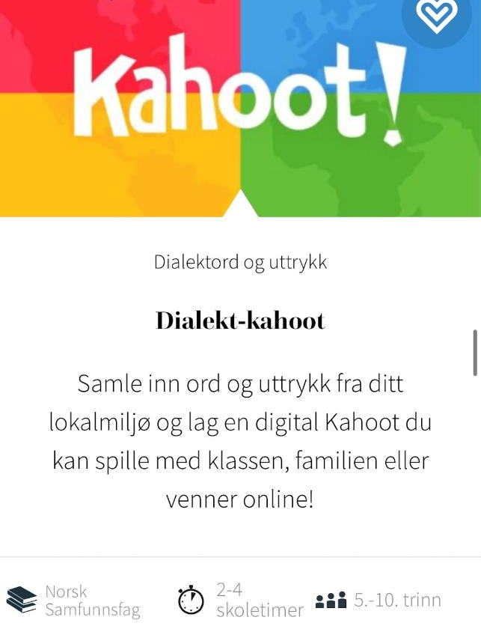
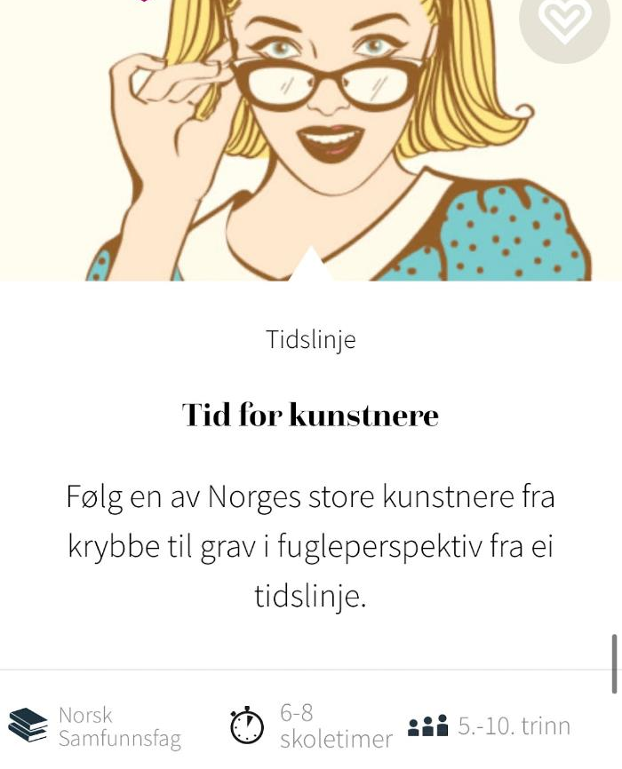
LANGUAGE
Step 3: Teaching assignments
Go on a treasure hunt in the cultural heritage - with teaching tasks developed for a number of subjects and all year levels!
Dialect-kahoot
Collect words and expressions from your local environment and create a digital Kahoot that you can play with your class, family or friends online!
Time for artists
Follow one of Norway’s great artists from cradle to grave in a bird’s-eye view from a timeline.

Slide 31


SAMI CULTURE
Step 3: Teaching assignments
Go on a treasure hunt in the cultural heritage - with teaching tasks developed for a number of subjects and all year levels!
Bidos - the Sami’s national dish
Try bidos, the Sami people’s traditional festive food with reindeer and vegetables.
Kahoot about Sami people’s day
Learn about Sámi People’s Day, Sámi culture and some Sámi words in a pinch.

Slide 32


Cultural monuments
Step 3: Teaching assignments
Go on a treasure hunt in the cultural heritage - with teaching tasks developed for a number of subjects and all year levels!
Clean up a cultural monument
Let the pupils do something practical by cleaning, making a path or putting up signs at a cultural monument in the local area.
Historical images in a new guise
Mix old photos with new ones and get a bit of the historical development in black and white.
.

Slide 33


OBJECTS
Step 3: Teaching assignments
Go on a treasure hunt in the cultural heritage - with teaching tasks developed for a number of subjects and all year levels!
Virtual time travel: Trade in the 18th century
Join us on a virtual time travel and discovery trip to the decade when the foundations of modern Norway were laid!
.
Time travel: Social inequality in the 18th century
Join us on a virtual time and class journey to a Norway in rapid development - and with huge social differences.

Slide 34


OBJECTS
Step 3: Teaching assignments
Go on a treasure hunt in the cultural heritage - with teaching tasks developed for a number of subjects and all year levels!
Time travel in 3D: Weather and vegetation in the 18th century
Join us on a virtual journey through time in a 3D model of Oslo harbor in the 18th century - and experience what weather and vegetation were like 200 years before our time.
.
Flåklypa Grand Quiz
Drag me backwards into the bird box… how well do you know this modern traditional treasure?

Slide 35


TIMELINE
Step 3: Teaching assignments
Go on a treasure hunt in the cultural heritage - with teaching tasks developed for a number of subjects and all year levels!
Time for house
How people lived in the past becomes clearer for the students when they themselves have to put the development of buildings into a timeline.
People in villages and towns
Put the development of your home place from the first settlements until 2040 into a timeline. How has the population trend changed?

Slide 36


MY IDENTITY
Step 3: Teaching assignments
Go on a treasure hunt in the cultural heritage - with teaching tasks developed for a number of subjects and all year levels!
The story of my…
Let students discover a different historical time through the eyes of a relative while getting to know both their family and themselves better.
A tree of relatives
Let the children explore their family through a family tree and calculate the number of first-borns and great-grandparents.

Slide 37


STONE AGE
Step 3: Teaching assignments
Go on a treasure hunt in the cultural heritage - with teaching tasks developed for a number of subjects and all year levels!
Build a Stone Age settlement
Stone Age cave of sticks, pieces of leather, a shoebox and some paint? Let the students live into the Stone Age through their own construction.
Still film - a day in the Stone Age
Bring the Stone Age to life in the classroom by having students write and direct their own still films.

Slide 38


GAMES AND ACTIVITIES
Step 3: Teaching assignments
Go on a treasure hunt in the cultural heritage - with teaching tasks developed for a number of subjects and all year levels!
Don't smile, don't laugh, don't bow your head!
Staying serious can be ridiculously difficult. This game is best outdoors.
Throw on the stick
Children today have little regard for real money. Practice your math skills with this classic.

Slide 39


GAMES AND ACTIVITIES
Step 3: Teaching assignments
Go on a treasure hunt in the cultural heritage - with teaching tasks developed for a number of subjects and all year levels!
The killer is on the loose
Ready for a criminally fun break?
Take that ring and let it wander..
Who does not remember this game from their own childhood? And what fun it was!

Slide 40


CULTURAL HERITAGE
TRACES OF PREVIOUS GENERATIONS
+ ACTIVE USE AND TRADITIONS IN OUR TIME
= VALUEABLE HERITAGE FOR THE FUTURE

