Slide 1
Partnership Levoca and Norsk Kultursenter

Slide 2
Cooporation between our nations
Culture cooporation
Exibitionls
Trees of Liberty
Bjørnstjerne Bjørnsson

Slide 3
Cooporation Levoca
Exchanging knowledge
Exiting project
Similar concept
Pasion for protect og histori for futere generations

Slide 4
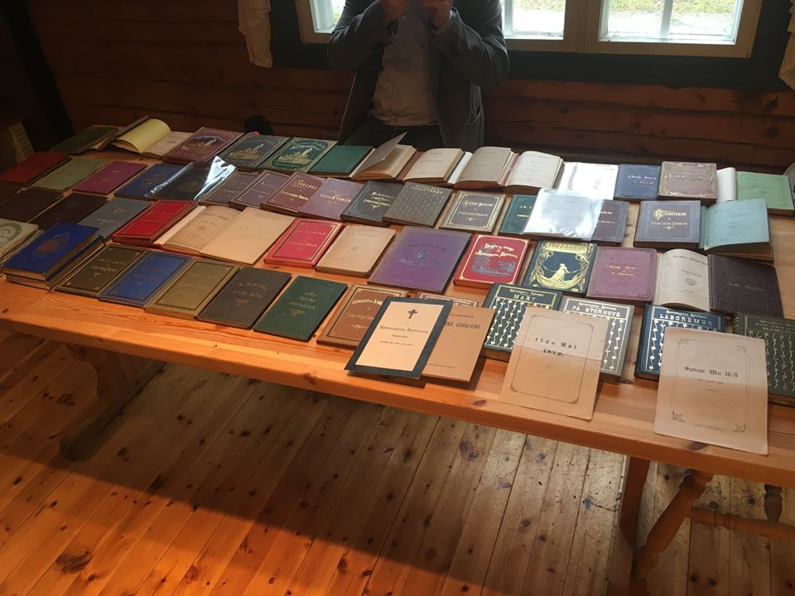
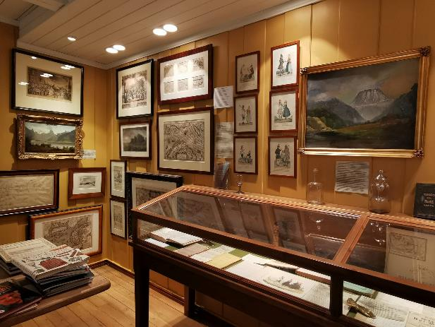
‘’Creation of a nation’’

Slide 5
‘’Creation of a nation’’
FROM THE CONSTITUTION IN 1814 – TO FULL INDEPENDENCE IN 1905
A SPECIAL FOCUS ON THE POET AND WRITER
BJØRNSTJERNE BJØRNSON (1832 – 1910)
AND THE COLLECTION OF DOCUMENTS, BOOKS, AND ART AT «NORSK KULTURSENTER» AT KOPPANG
Short summary og the background for 1814 and 1905:

Slide 6
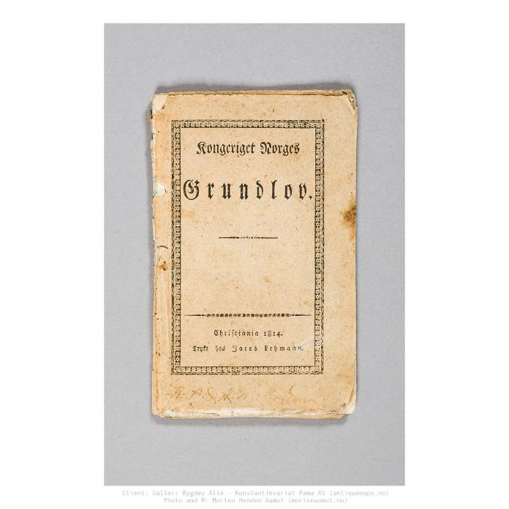
‘’Creation of a nation’’

Slide 7
‘’Creation of a nation’’

Slide 8
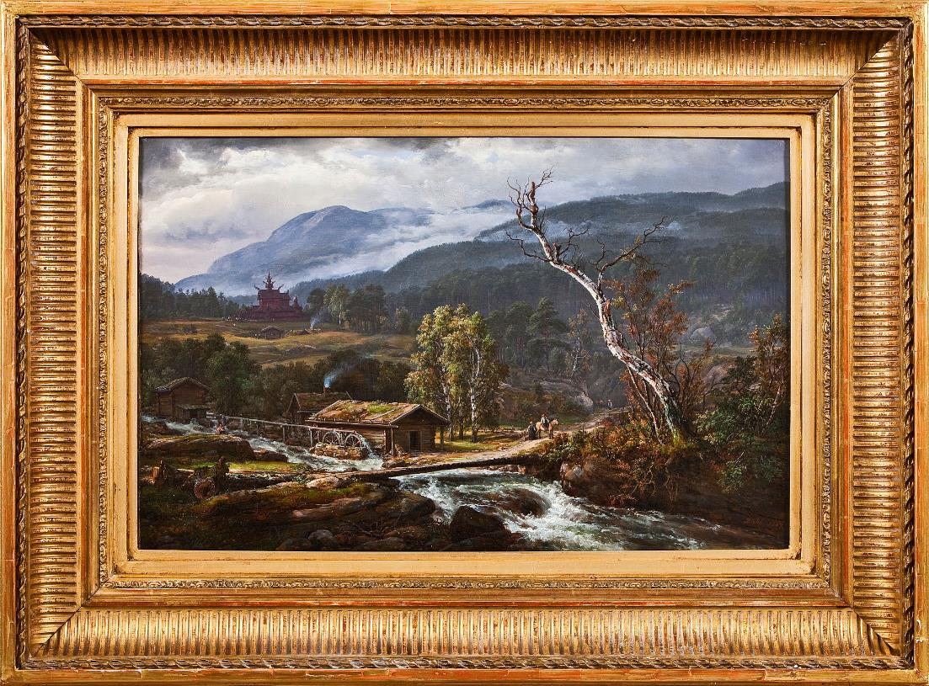
‘’Creation of a nation’’

Slide 9
‘’Creation of a nation’’

Slide 10
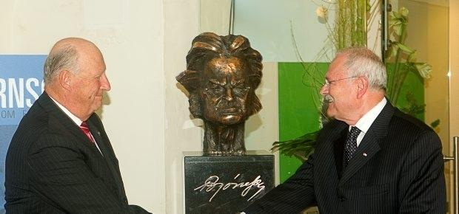
Bjørnstjerne bjørnson

Slide 11
Bjørnstjerne bjørnson
First edition of the National Anthem of Norway
The only copy in private ownership

Slide 12
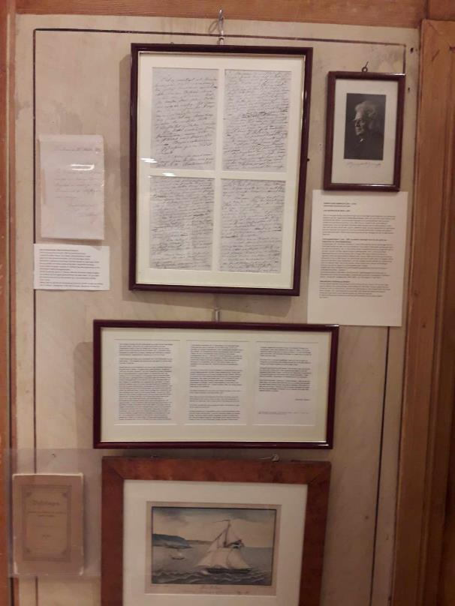
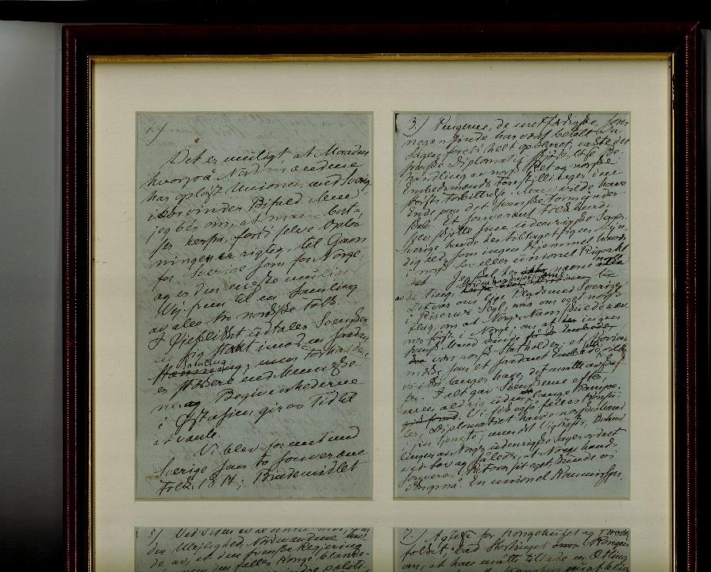
Bjørnstjerne bjørnson

Slide 13
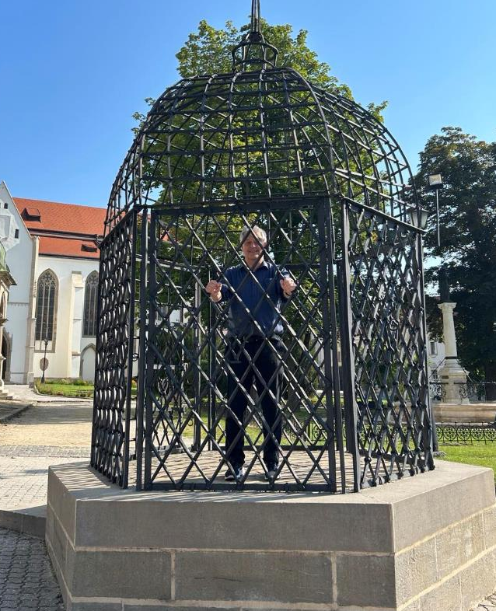
Thank you for your attention

